Slide 1
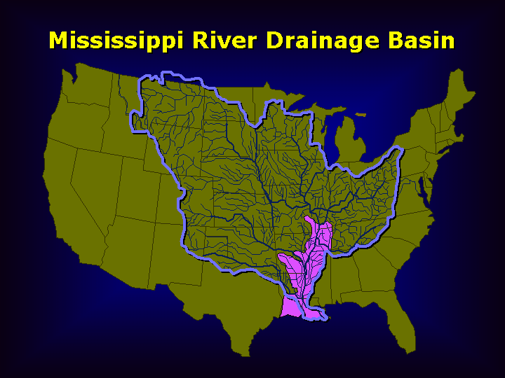
The Mississippi River, A School of Democracy:
Five Crises That Drove Collaboration On The Rivers

Slide 2
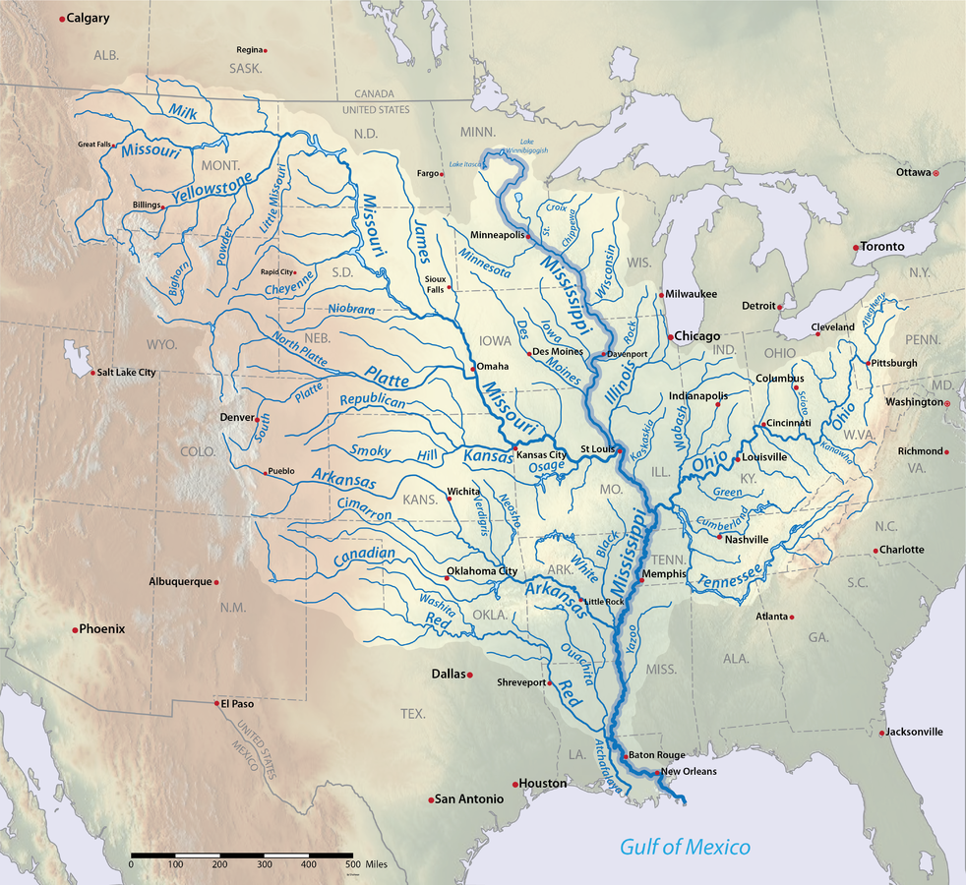
Drains 10 States
$400-500 Billion a Year in Economic Activity
Supports 1 Million Jobs
Gulf is one of the world’s largest export corridor
Mississippi river system (including tributaries) has about 18,000+ miles of navigable waterways

Slide 3
Public / Private Collaboration On The Waterways
American Waterways Operators - advocacy organization for barge operators River Industry Executive Task Force (RIETF)--standing task force of the AWO; fosters dialogue between Corps of Engineers, U.S. Coast Guard, and the inland towing industry, formed in 1988 Lower Mississippi River Committee (LOMRC)--industry group works with Corps on dredging and navigation Regional Dredging Teams (RDTs) / Harbor Safety Committees (HSCs) Inland Waterways Users Board (IWUB)--advises Corps on lock and dam construction Marine Transportation System National Advisory Committee (MTSNAC) --chartered interagency body, advises Sec. of Transportation on maritime issues. Committee on the Marine Transportation System (CMTS)--another federal interagency body. Waterways Council, Inc. (WCI) – advocates for waterways infrastructure National Waterways Council – research arm of WCI Area Maritime Security Committees (AMSCs) / Port-level Working Groups / COTP coordination Port Authorities & Port Commissions / Statistical Port Groupings Gulf Intracoastal Waterway stakeholder groups / GICA / American Association of Port Authorities

Slide 4
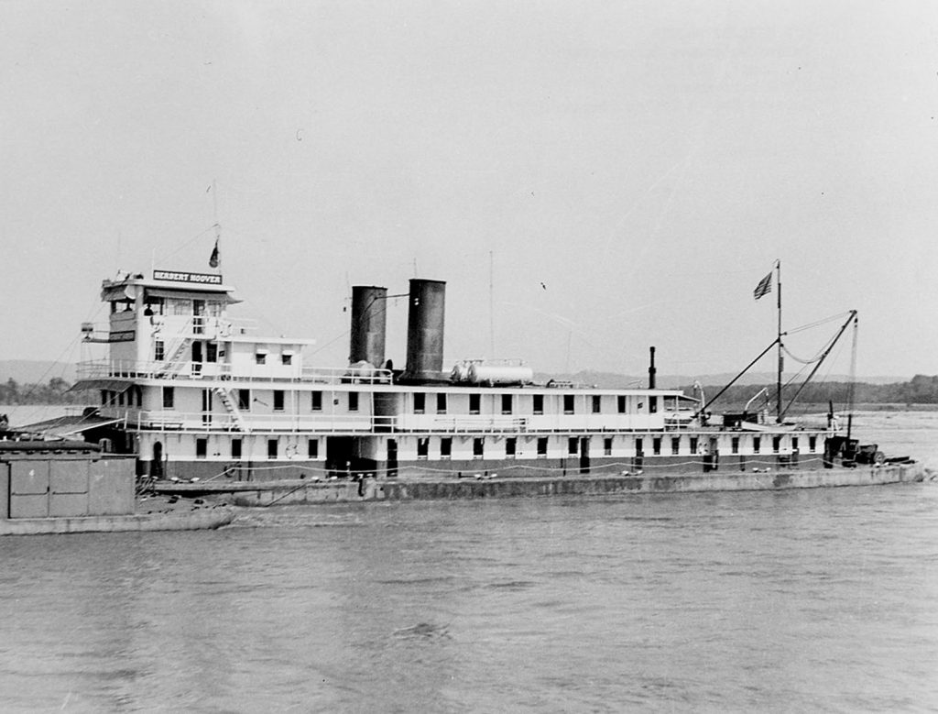
World War I - Inland Waterways Corporation / Federal Barge Line (1920-1953) The Herbert Hoover (below) was a flagship of the IWC, which pioneered towboat innovation and the switch to diesel-power screw vessels

Slide 5
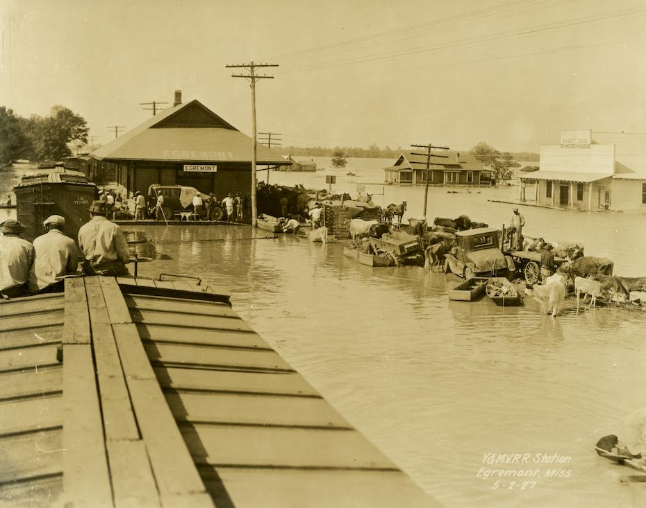
1926-7: Mississippi River Flood
Flood Control Act of 1928 authorized the Corps of Engineers to build levees, reservoirs, and navigation structures. It further “federalized” the river system, especially the Mississippi River. Flood control was linked to navigation improvements.

Slide 6
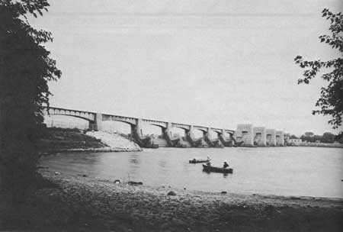
New Deal 9-Foot Channel Project
Rivers and Harbors Act of 1930 authorized a 9-foot channel project on the Upper Mississippi (from Minneapolis, MN, to St. Louis, MO). 23 lock and dam sites between Minneapolis (Lock & Dam 1) and Alton, Illinois (Lock & Dam 26 at the time). Illinois Waterway; 7 locks and dams completed 1933. Below: Lock & Dam 13, Davenport, Iowa

Slide 7
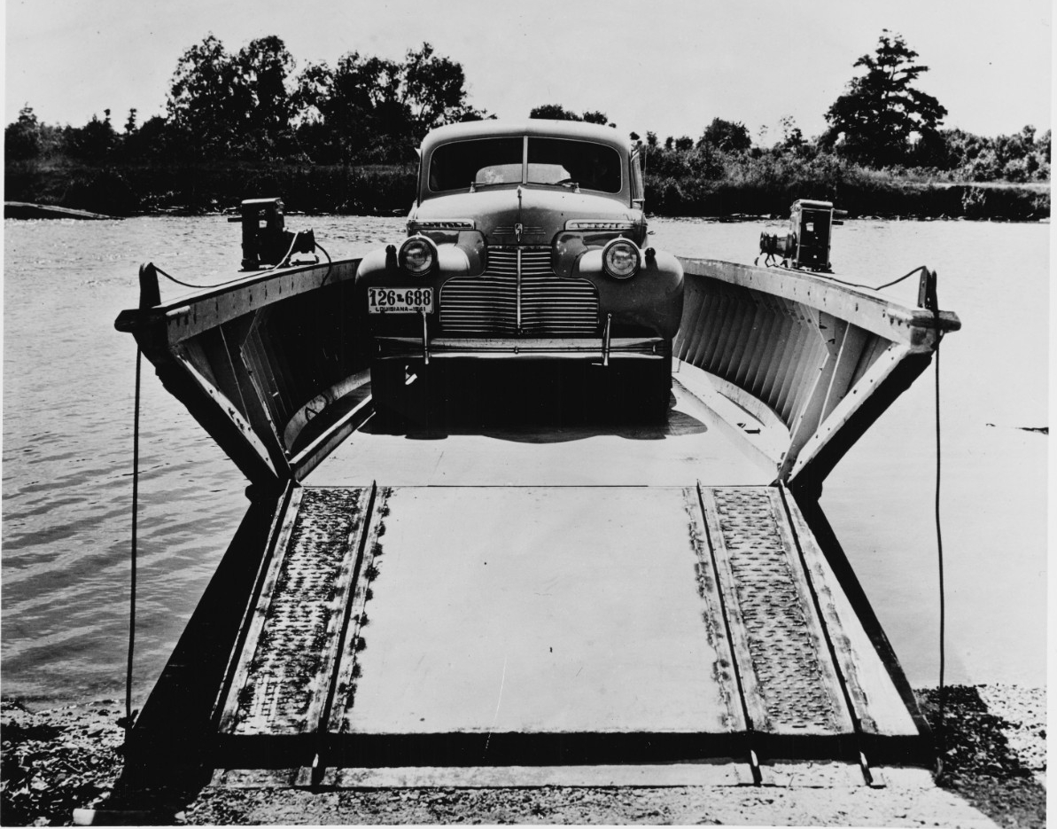
World War II
War agencies coordinated closely with barge operators, standardized barge designs, and provided resources to maximize inland waterway use.

Slide 8
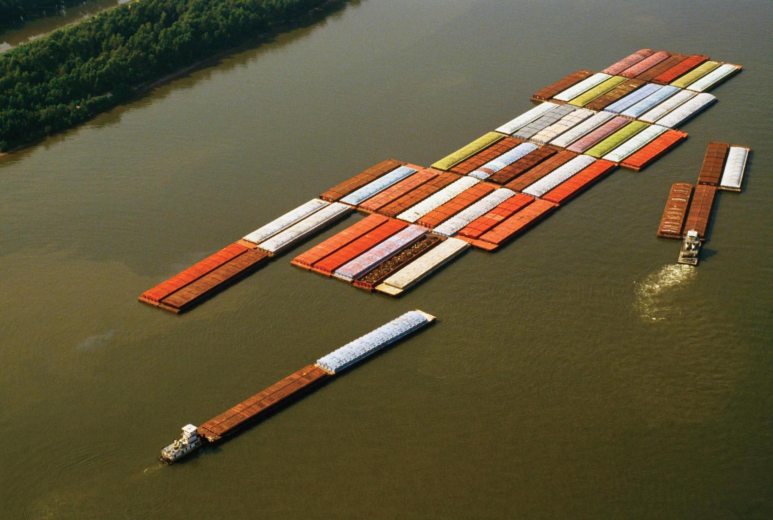
1970’s: Earl Butz’s Ag Export Push

Slide 9
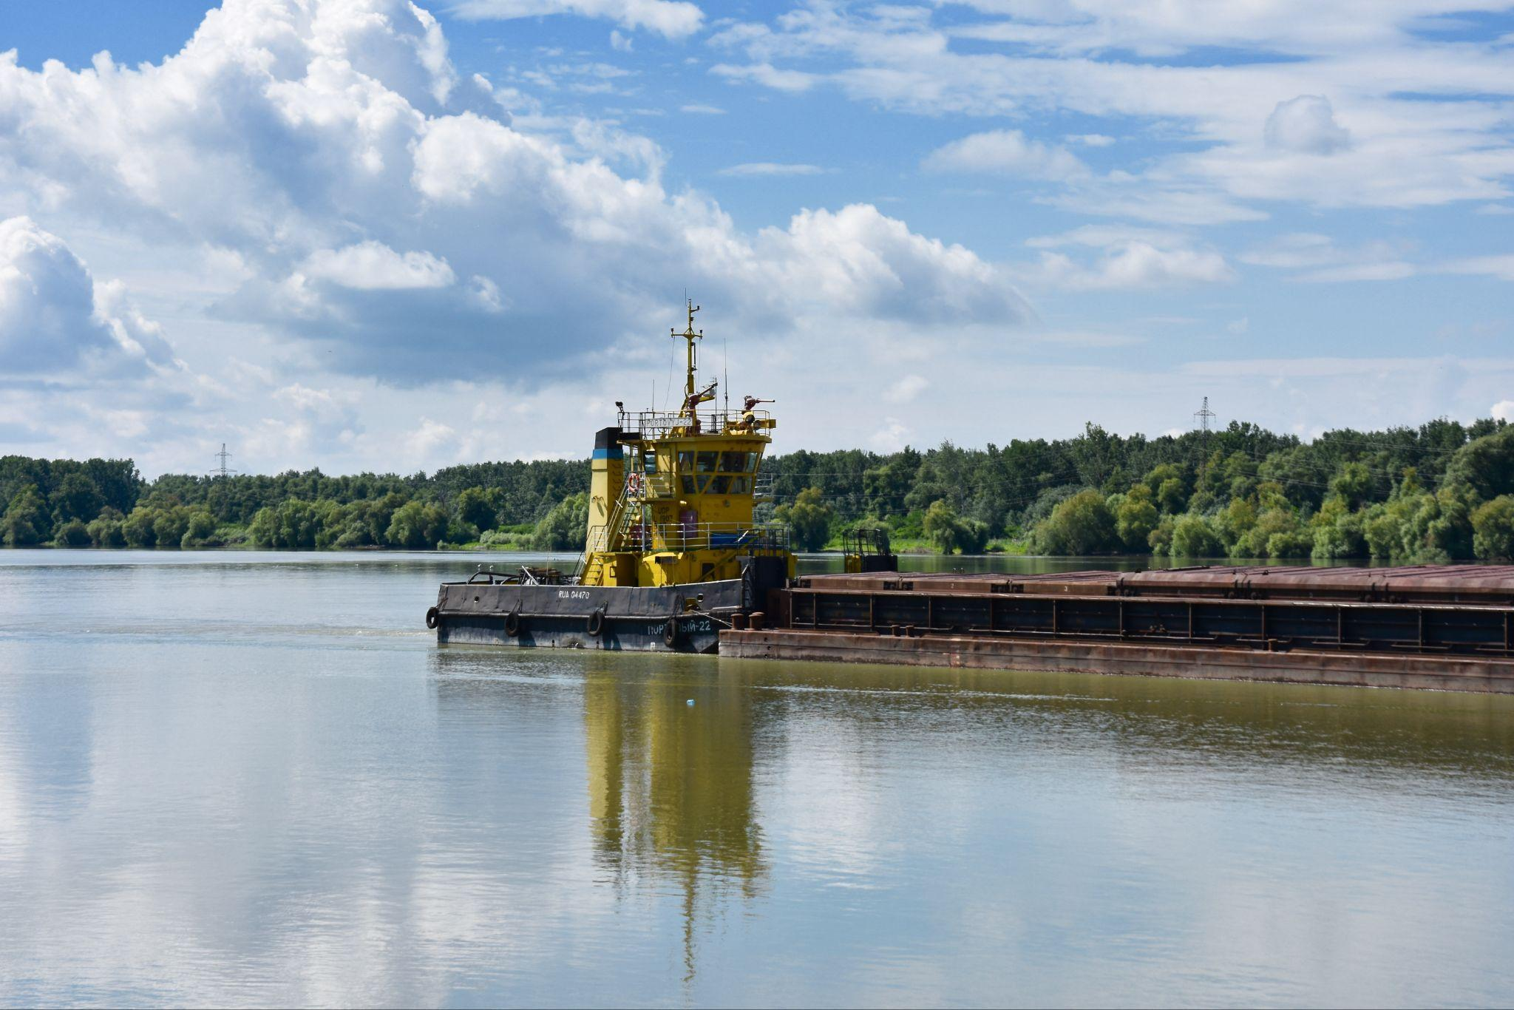
1978-80: Crash, recovery and a seat at the table
The Inland Waterways Users Board is created as part of the Inland Waterways Revenue Act of 1978 (Public Law 95-502). It established the fuel tax on barges that finances the Inland Waterways Trust Fund (IWTF).
The IWUB advises the U.S. Army Corps of Engineers and Congress on prioritization, funding, and management of IWTF projects for the inland and intracoastal waterways system. / “You pay, you say”.

Slide 10

David A. Murray
Senior Writer,
The Waterways Journal
david@wjinc.net
www.waterwaysjournal.com

